Slide 1

Transfer Learning At Scale in NLP

Slide 2
Workshop Outcome
Transfer learning in context
Transformers
How to use them
Transfer Learning at Scale
Correlation vs Causation
Let’s start with the first set of slides

Slide 3
Introduction to Transfer Learning (TL)
What is TL ?
Why TL ?
Evolution of TL

Slide 4
What is TL ?
Storing knowledge gained solving one problem and applying it to a different but related problem
Domain A
Domain B
Model A
Model B
Knowledge

Slide 5

Example of TL
Predicts objects in image
Deep CNN (Model A)
Input image
ImageNet (Domain A)

Slide 6

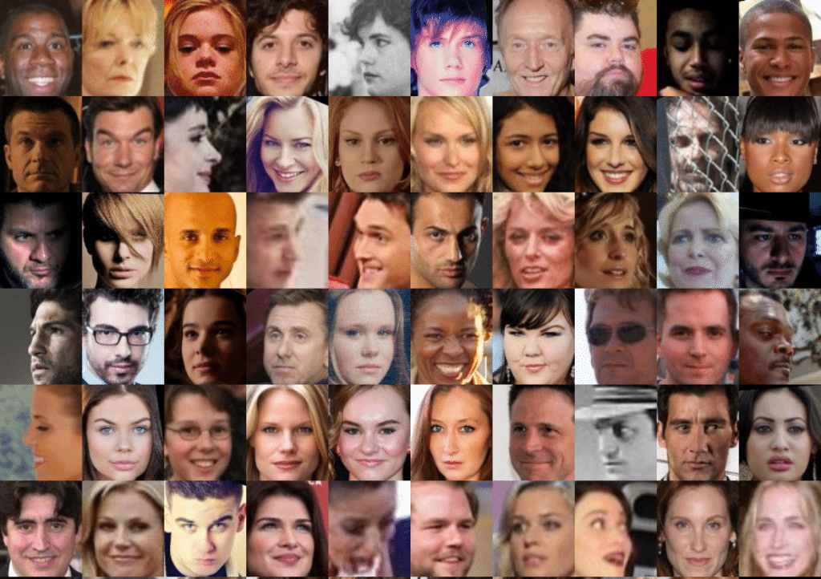
Example of TL
Predicts objects in image
Input image
Domain B

Slide 7
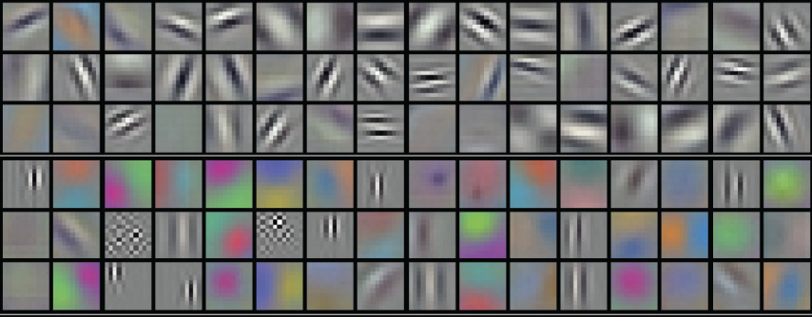
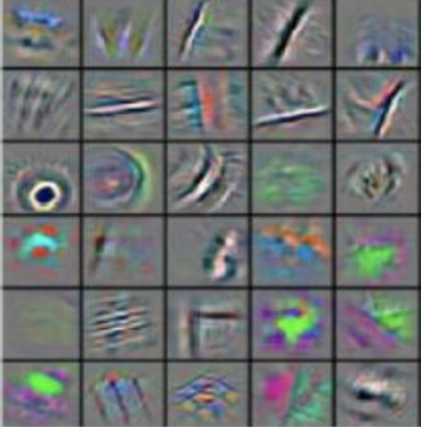
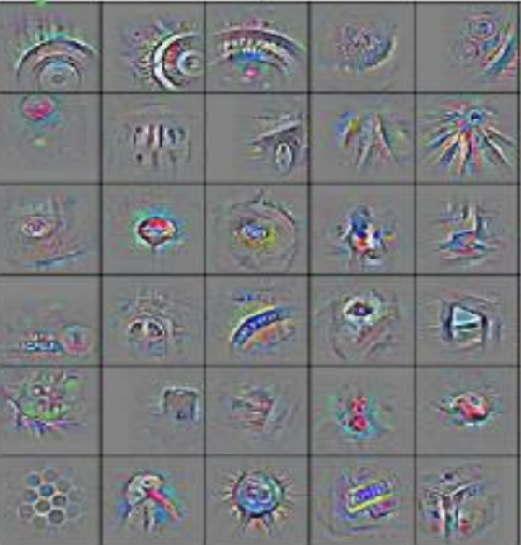
Example of TL
Identify face
Knowledge on how to extract visual features is shared !
Input image

Slide 8
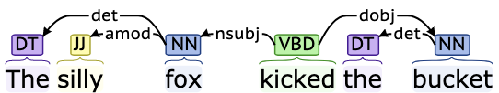
Why TL for NLP ?
Difficulty of getting annotated data
How to help low-annotated data tasks?
Adoption in computer vision
Huge success applying transfer learning for images
Structure of language
Hierarchical structure: high-level features are composed of lower-level features
Shared structure: grammar is fuzzy but mostly generalizable
Characters
Morphemes
Words
Phrases
Sentences
Paragraphs
Documents
(https://corenlp.run/)

Slide 9
Evolution of TL in NLP
1960
1970
1980
1990
2000
2010
2020
Context-free grammar
CYK Parser
Ontologies
HMMs
LSA
www
n-grams
Neural Language Model
CRF
Multitask Learning
Seq2Seq
BERT
Transformer
tf-idf
Attention
LSTM
LDA
Word2vec
RNNs
CNNs
Linguistic + CS
Linguistic + stat / ML
ML / DL
TL

Slide 10
Word2vec
Distributional Hypothesis (1954): “a word is characterized by the company it keeps”
The brown fox jumped over the lazy dog
CBOW
Skipgram
+
the
Context predicts middle word
Middle word predicts context
over
jumped
fox
brown

Slide 11
Word2vec
After training word2vec we have one vector per word:
We can compute similarities between vectors:
Word | dog
Top 10 Nearest Neighbors | dogs puppy pit_bull pooch cat golden_retriever German_shepherd Rottweiler beagle pup
cat
0.3, 0.6, -0.7, ...
dog
0.9, -0.2, -0.1, ...
computer
0.3, 0.1, 0.1, ...
machine
-0.4, 0.2, -0.5, ...

Slide 12

Anything2vec
The Smthg2vec was extended to pretty much anything e.g. for sentences
For documents/paragraphs:
Doc2vec
...
For sentences:
Infersent
Skipthought
Sent2vec
...
For graphs:
Node2vec
Graph2vec
...

Slide 13
Context Issue
Static embedding methods are not very good at encoding the context
“Yesterday I followed the bank of the river to go to the bank”
polysemy
“Her favorite fruit is date”
“He took her out on a date”
“What’s your date of birth?”
word2vec(“date”) = [0.1, -0.2, ...]
“This movie was not good at all !”
negation / non-compositionality
“Lasers are amazing devices, they can be used … ”
co-reference

Slide 14
Language Models
Language models model the probability distribution of a sequence of tokens (e.g., words)
Trained to predict the next word
Training data is easy to gather (e.g., wikipedia)
Do not require labelled data

Slide 15

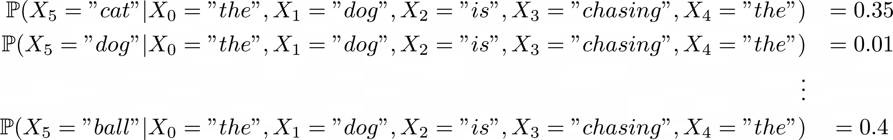
Language Models
Learning conditional probability distribution: P(w_{t}|w_{t-1}, w_{t-2}, … )
the
…
The dog is chasing the
0, 146, 145, 3465
dog
ball
…
cat
Model
(ngrams, RNNs, ...)
…

Slide 16
RNN Language Model
cab
run
…
…
…
cat
dog
bark
is
barking
chasing
…
man
…
has
…
running
…
…
…
softmax
softmax
softmax
Language models learns syntax and semantics to solve the task
Can learn representation for words/sentences that can be leveraged for downstream tasks
o1
o2
o3
...
Wo
Wo
Wo
h1
Wh
h2
Wh
h3
...
Wx
Wx
Wx
...
0.2
0.6
-0.3
...
...
0.1
-0.5
0.2
...
...
-0.2
0.9
-0.7
...
x1 =
x2 =
x3 =
...
“the”
“dog”
“is”

Slide 17
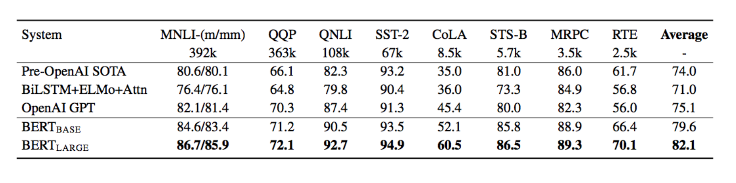
Transformer Language Model
Models such as GPT and BERT introduced transformers to model language
The scores of those models on downstream tasks significantly beat the previous state of the art:

Slide 18
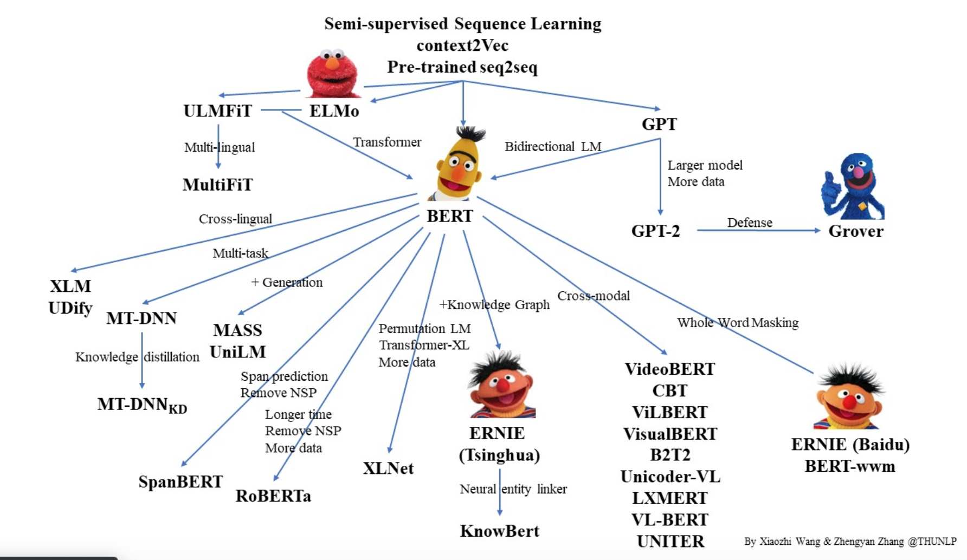
Transfer Learning Explosion

Slide 19
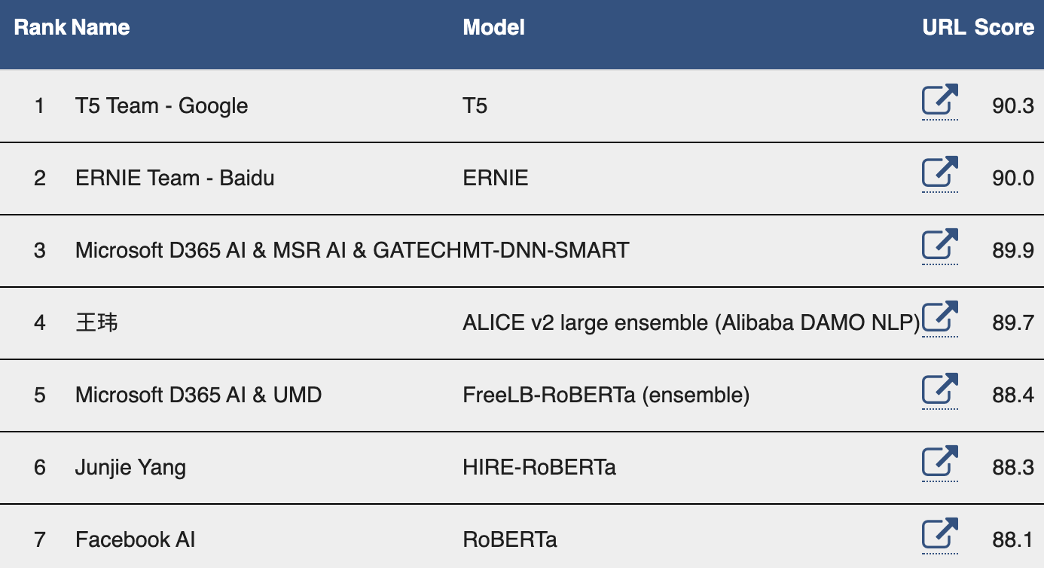
GLUE Benchmark

Slide 20
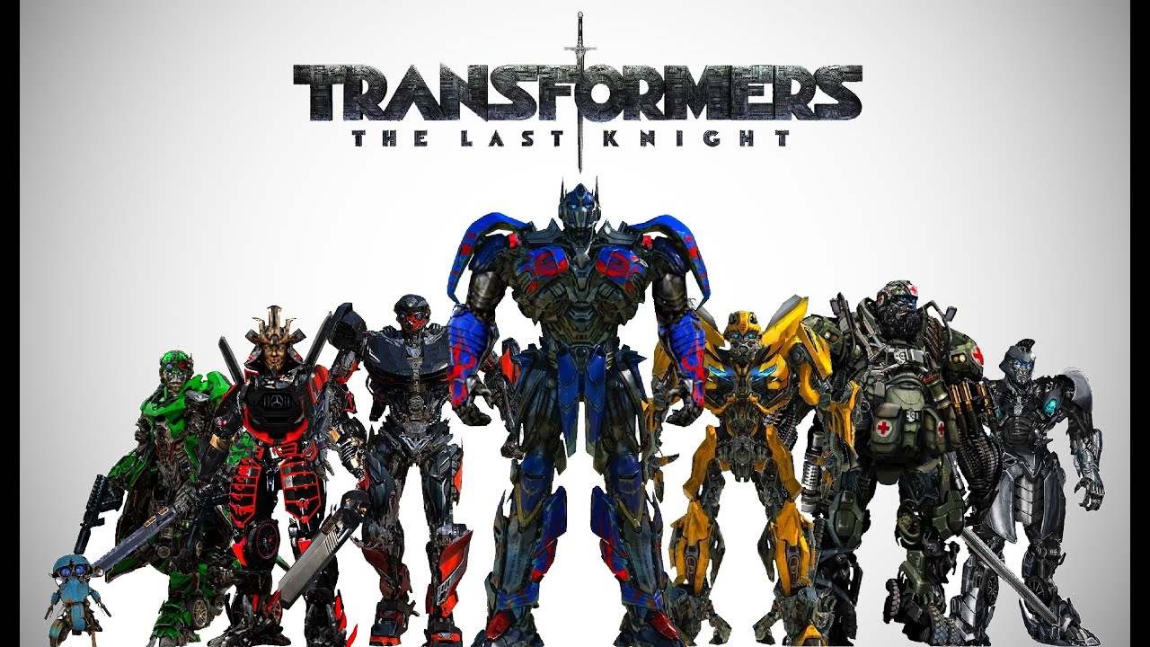
2. Transformers
Why transformer ?
Multi-head attention
BERT Architecture

Slide 21
Motivation
RNN/LSTM are not parallelizable as everything is sequential
Long-range dependencies problem of RNNs
Attention mechanisms can allow us to attend any kind of position without the sequential feature of RNNs
Layer 3
Layer 3
Layer 2
Layer 2
Layer 1
t
t+1
t+2
t+3
t+4
Layer 1
RNN
t
t+1
t+2
t+3
t+4
Transformer

Slide 22
Transformer Encoder
Output probas
Softmax
Linear
Layer Norm
The Encoder is composed of multiple layers of :
multi-head self-attention mechanism
Position-wise feedforward network
Transformers are working on sets, the structure of the data e.g. sequence, needs to be encoded by using masking and/or positional embeddings
+
Feed Forward
N layers
Layer Norm
+
Multi-head Attention
+
Positional Encoding
Input embeddings
Inputs
Highly recommend “The Annotated Transformer”: http://nlp.seas.harvard.edu/2018/04/03/attention.html

Slide 23
Transformer Encoder
Output probas
Output probas
Output probas
Output probas
Softmax
Softmax
Softmax
Softmax
Linear
Linear
Linear
Linear
Feed-Forward
Feed-Forward
Feed-Forward
Feed-Forward
Multi-head Attention
Multi-head Attention
Multi-head Attention
Multi-head Attention
Feed-Forward
Feed-Forward
Feed-Forward
Feed-Forward
Multi-head Attention
Multi-head Attention
Multi-head Attention
Multi-head Attention
+
+
+
+
Input embedding
Input embedding
Input embedding
Input embedding
t
t+1
t+2
t+3

Slide 24
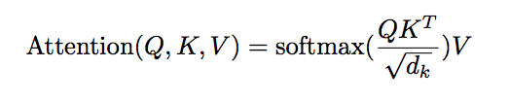
Multi-Head Self-Attention
Attention can be abstracted as: Attention(Query, Keys , Values)
Dot product between query and key measures the relevance of a given value:
a
into
bar
walks
An
engineer
ML
An ML engineer walks into a bar
An
Values
ML
Keys
engineer
walks
Queries
into
a
bar
“Attention is all you need” https://papers.nips.cc/paper/7181-attention-is-all-you-need.pdf

Slide 25
Multi-Head Self-Attention
Attention can be abstracted as: Attention(Query, Keys , Values)
Dot product between query and key measures the relevance of a given value:
a
into
bar
walks
An
engineer
ML
An ML engineer walks into a bar
An
Values
ML
Keys
engineer
walks
Queries
into
a
bar
“Attention is all you need” https://papers.nips.cc/paper/7181-attention-is-all-you-need.pdf

Slide 26
Multi-Head Self-Attention
Attention can be abstracted as: Attention(Query, Keys , Values)
Dot product between query and key measures the relevance of a given value:
a
into
bar
walks
An
engineer
ML
An ML engineer walks into a bar
An
Values
ML
Keys
engineer
walks
Queries
into
a
bar
“Attention is all you need” https://papers.nips.cc/paper/7181-attention-is-all-you-need.pdf

Slide 27
Multi-Head Self-Attention
Attention can be abstracted as: Attention(Query, Keys , Values)
Dot product between query and key measures the relevance of a given value:
a
into
bar
walks
An
engineer
ML
An ML engineer walks into a bar
An
Values
ML
Keys
engineer
walks
Queries
into
a
bar
“Attention is all you need” https://papers.nips.cc/paper/7181-attention-is-all-you-need.pdf

Slide 28
Multi-Head Self-Attention
Attention can be abstracted as: Attention(Query, Keys , Values)
Dot product between query and key measures the relevance of a given value:
a
into
bar
walks
An
engineer
ML
An ML engineer walks into a bar
An
Values
ML
Keys
engineer
walks
Queries
into
a
bar
“Attention is all you need” https://papers.nips.cc/paper/7181-attention-is-all-you-need.pdf

Slide 29

BERT
BERT introduced bidirectionality by using a transformer instead of an LSTM encoder
Uses two objectives:
Mask Language Model (MLM)
next sentence prediction (NSP)
Uses special tokens to format the input: [CLS], [SEP], [MASK]
NSP
MLM
MLM
MLM
Transformer
Segment embeddings
E_{A}
E_{A}
E_{A}
E_{A}
E_{A}
E_{A}
E_{A}
E_{A}
E_{A}
E_{B}
E_{B}
E_{B}
E_{B}
E_{B}
E_{B}
E_{B}
+
+
+
+
+
+
+
+
+
+
+
+
+
+
+
+
Position embeddings
E₀
E₁
E₂
E₃
E₄
E₅
E₆
E₇
E₈
E₉
E₁₀
E₁₁
E₁₂
E₁₃
E₁₄
E₁₅
+
+
+
+
+
+
+
+
+
+
+
+
+
+
+
+
Token Embeddings
[CLS]
The
dog
[MASK]
to
school
today
.
[SEP]
He
learnt
[MASK]
to
[MASK]
TL
[SEP]
“BERT: Pre-training of Deep Bidirectional Transformers for Language Understanding” https://arxiv.org/pdf/1810.04805.pdf

Slide 30
NSP
MLM
MLM
MLM
Softmax
Softmax
Softmax
Softmax
Linear
Linear
Linear
Linear
FF
FF
FF
FF
FF
FF
FF
FF
FF
MHA
MHA
MHA
MHA
MHA
MHA
MHA
MHA
MHA
FF
FF
FF
FF
FF
FF
FF
FF
FF
MHA
MHA
MHA
MHA
MHA
MHA
MHA
MHA
MHA
+
+
+
+
+
+
+
+
+
Embs
Embs
Embs
Embs
Embs
Embs
Embs
Embs
Embs
[CLS]
An
ML
[MASK]
[MASK]
[SEP]
Great
[MASK]
[SEP]

Slide 31
3. How to use
Bert in Practice
Keeping Bert Parameters fixed
Finetuning Bert Parameters
What/When to Choose

Slide 32
Using BERT in a real system
How many queries per sec?
Accuracy
Is the gain really worth it?
Throughput/
Latency
Scalability
Memory
How much will I suffer to distribute it?
How much (CPU or GPU) memory can I use?
Which hardware?

Slide 33


Static Features
Possible to extract all the layers output from the Transformer
Learn a linear combination of the layers
Final prediction
LSTM / CNN
Aggregation over layers
BERT
I
love
this
movie
“ELMo ” https://arxiv.org/abs/1802.05365

Slide 34
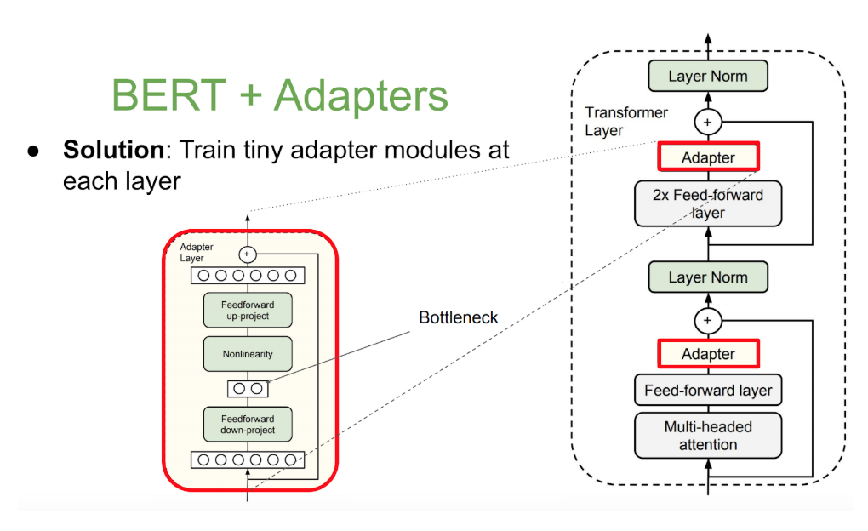
Adapter Modules
“Parameter-efficient Transfer Learning for NLP” http://proceedings.mlr.press/v97/houlsby19a.html

Slide 35
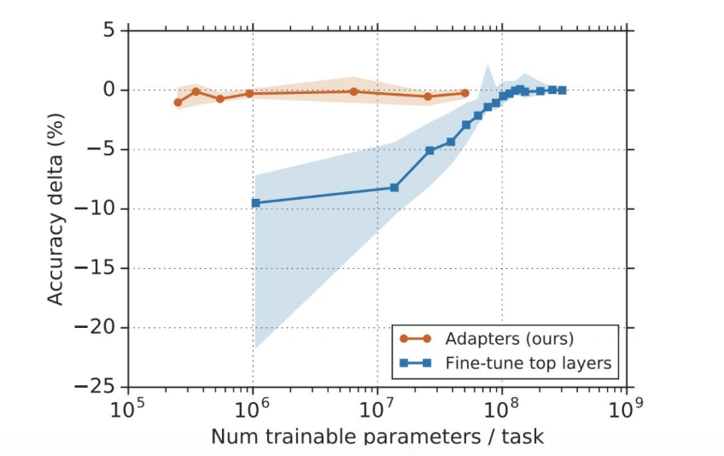
Adapter Modules
Adapters ⇒ obtain good accuracy with less weights to tune!
“Parameter-efficient Transfer Learning for NLP” http://proceedings.mlr.press/v97/houlsby19a.html

Slide 36

Adaptation on Downstream Task
We load our pretrained LM transformer model with already trained weights
Add a new linear layer on top of the trained model
Finetune the parameters of the newly defined model on the downstream task
Evaluate
Question: What could go wrong?
BERT
Let’s start with the first set of slides
[CLS]
I
love
this
movie

Slide 37
Catastrophic Forgetting
Accuracy
Learning new task B
Performance degradation on task A
Epoch
Training a model pre-trained on task A, on a new task B

Slide 38
Finetuning
Careful not to change too much the pretrained weights (Catastrophic forgetting)
Use small learning rates to avoid big changes:
Especially for lower layers which capture general information (https://arxiv.org/abs/1801.06146)
Learning rate warmup
Regularization:
Elastic Weight Consolidation (https://arxiv.org/abs/1612.00796)
Simple L2 regularization

Slide 39
Finetuning
Several methods are possible:
Freezing everything but the top layer (https://arxiv.org/abs/1502.02791)
Training one layer at a time (https://www.aclweb.org/anthology/D17-1169/)
Gradually unfreezing (https://arxiv.org/abs/1801.06146)
Finetune all parameters
“Transfer Learning in Natural Language Processing”, NAACL tutorial.

Slide 40
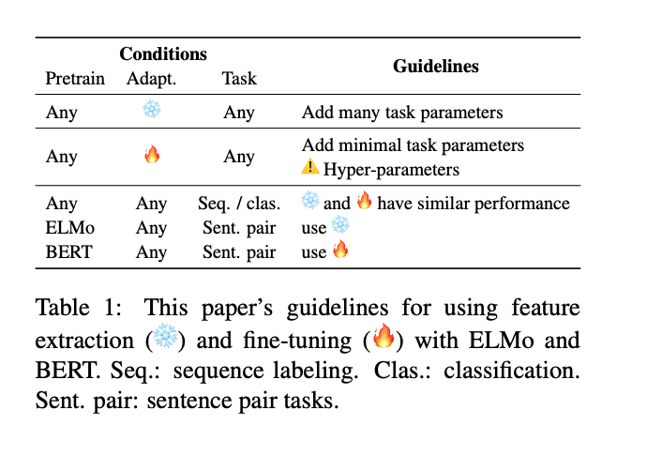
What/When to choose
“To Tune or Not to Tune? Adapting Pretrained Representations to Diverse Tasks”, https://arxiv.org/pdf/1903.05987.pdf

Slide 41
Pain Points
The feedforward pass is slow (Bert Large has 335M parameters)
Fine-tuning is very unstable (https://arxiv.org/pdf/1811.01088.pdf)
Memory problems if the maximum sequence length is long
You can pre-train your own version of Bert on your dataset
Requires lots of GPUS/TPUS
Tricky to choose hyper-parameters

Slide 42
Hands-on
Fine-tuning
https://tinyurl.com/uku8sag

Slide 43
Results from Colab
 | Inference Speed for 5000 sents (seconds) | F1-score | GPU Memory (MiB) | Model Size on Disk (MB) | # Parameters (Millions)
Bert (Finetuning) | GPU: 48 CPU: 191 | 0.88 | 4163 | 438 | 110
Simple Binary Clf | GPU: 0.87 CPU: 3.1 | 0.81 | 1187 | 10 | 2.5
GPU: Tesla T4 15GB RAM
CPU: Intel(R) Xeon(R) CPU @ 2.20GHz

Slide 44
Using BERT in a real system
How many queries per sec?
Accuracy
Is the gain really worth it?
Throughput/
Latency
Scalability
Memory
How will I handle parallelization?
How much (CPU or GPU) memory can I use?

Slide 45

Freezing vs Finetuning
BERT
BERT
BERT
BERT
BERT
server(s)
server(s)
Feature serving
Model serving

Slide 46
4. Transfer
Learning At Scale
Tokenization
Distillation
Quantization
Serving models at scale

Slide 47
Tokenization
Reduce Latency of your system
Final prediction
Trained Model
 | Time (seconds)
Normal Tokenizer | 26
HuggingFace Tokenizer | 3.18
I
play
##ed
football
Tokenization
I played football

Slide 48
Knowledge Distillation

Slide 49
Knowledge Distillation
Teacher
(e.g. finetuned BERT)
Data
Student Loss
Student
(e.g. LSTM)

Slide 50
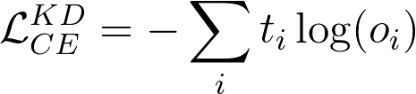
Teachers predictions
No Labels Needed
Input
Logits
output
labels
-0.1
1.5
0.3
softmax(fstudent(x))
0.9
0.05
0.05
0
1
0
...
0.2
0.6
-0.3
...
fstudent(x)
Teacher preds
fteacher(x)
0.1
0.9
0
Possible to do Data augmentation

Slide 51
Teachers Logits
Student logits
Input
output
labels
-0.1
1.5
0.3
softmax(fstudent(x))
0.9
0.05
0.05
0
1
0
...
0.2
0.6
-0.3
...
fstudent(x)
fteacher(x)
1.4
0.2
-0.4
Teacher logits

Slide 52
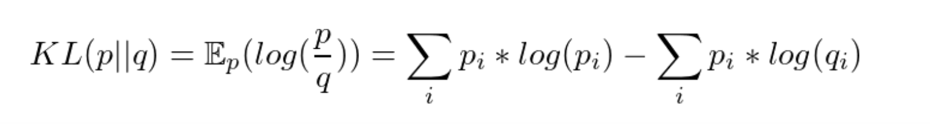
Knowledge Distillation
DistilBert is training a subnetwork of the original network to profit from good layer initialization
DistilBert uses KL divergence loss :
Other work have managed to distilbert into small networks (Bi-LSTM) https://arxiv.org/abs/1903.12136v1
Let’s start with the first set of slides
Lhttps://medium.com/huggingface/distilbert-8cf3380435b5et’s start with the first set of slides

Slide 53
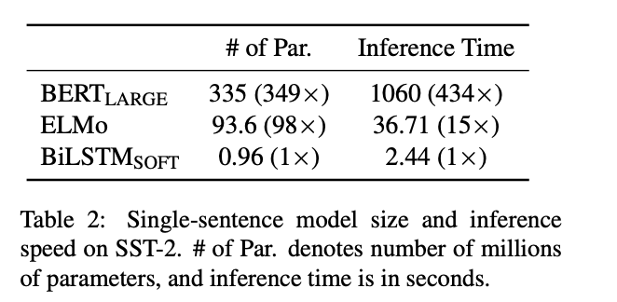
Knowledge Distillation
Let’s start with the first set of slides
“Distilling Task-Specific Knowledge from BERT into Simple Neural Networks”: https://arxiv.org/abs/1903.12136v1

Slide 54
Hands-on
Distillation
https://tinyurl.com/uku8sag

Slide 55
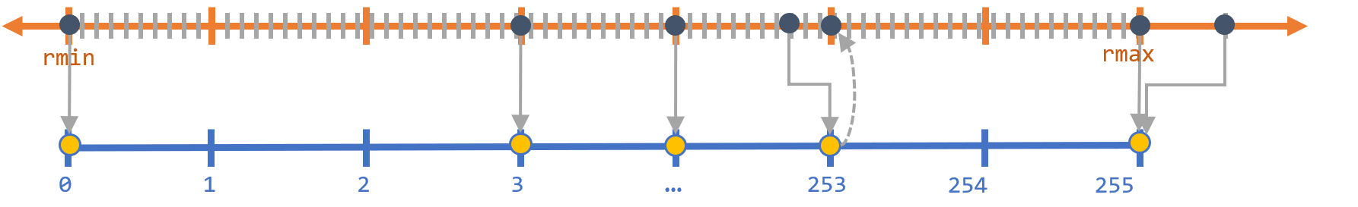
Quantization
Quantization aims to store tensors at lower bitwidth (e.g., Integer instead of floating point)
We can try to map floats to integers:
[r_{min}, r_{max}] → [0, 2^{B}-1]
“quantization-in-tflite” https://sahnimanas.github.io/post/quantization-in-tflite/

Slide 56
Why Quantization
Models benefit from hardware optimizations → faster
Significantly reduce the memory footprint! → Smartphone friendly!
On deep network, quantization usually do not significantly degrade the performances
“quantization-in-tflite” https://sahnimanas.github.io/post/quantization-in-tflite/

Slide 57
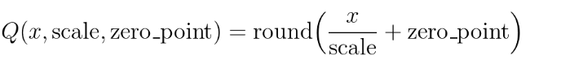
Quantization
0.2 -0.5
1.3 1.9
q₁
q₂
1 -2
5 8
x₂
x₁
“Pytorch quantization” https://pytorch.org/docs/stable/quantization.html

Slide 58
Quantization
Models can be quantized post-training and during training.
During training:
Quantize weights in the forward pass
Backward pass and the update are with regard to the unquantized weights
Post-training:
Use unquantized weights while training
Quantize weights after training and perform inference

Slide 59
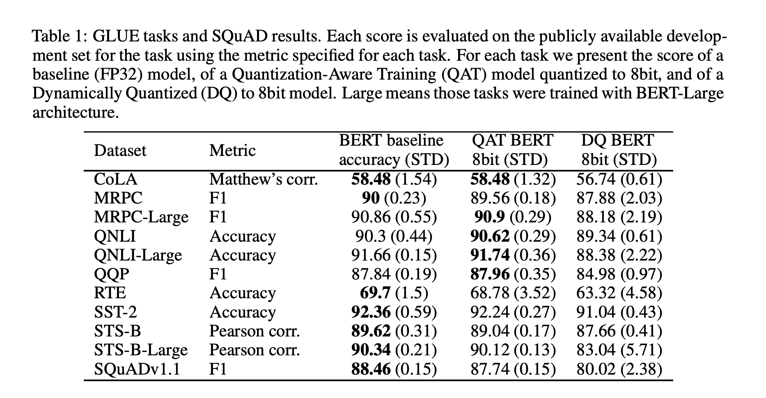
Quantized 8bit BERT
“Q8BERT: Quantized 8Bit BERT” https://arxiv.org/pdf/1910.06188.pdf

Slide 60
Hands-on
Quantization
https://tinyurl.com/uku8sag

Slide 61
Serving Models at Scale
Containerize your model to make replication easy
Use spot instances (Cost savings)
Orchestrate your containers for autoscaling
Handle the serving, logging, monitoring, ...

Slide 62
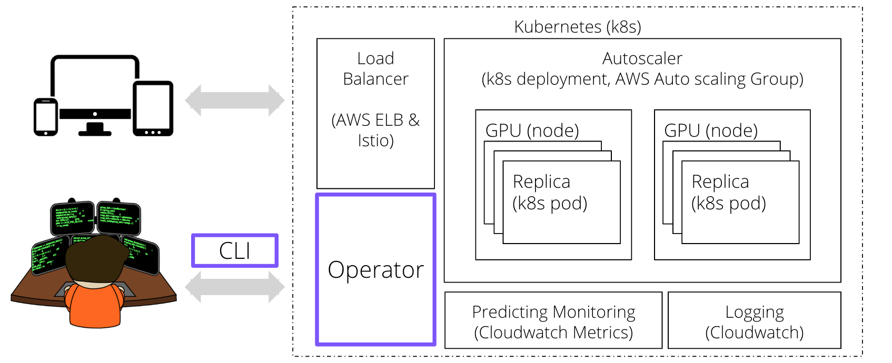
Serving Models at Scale
https://www.cortex.dev/

Slide 63
Live Demo
Deploy a model using Cortex

Slide 64
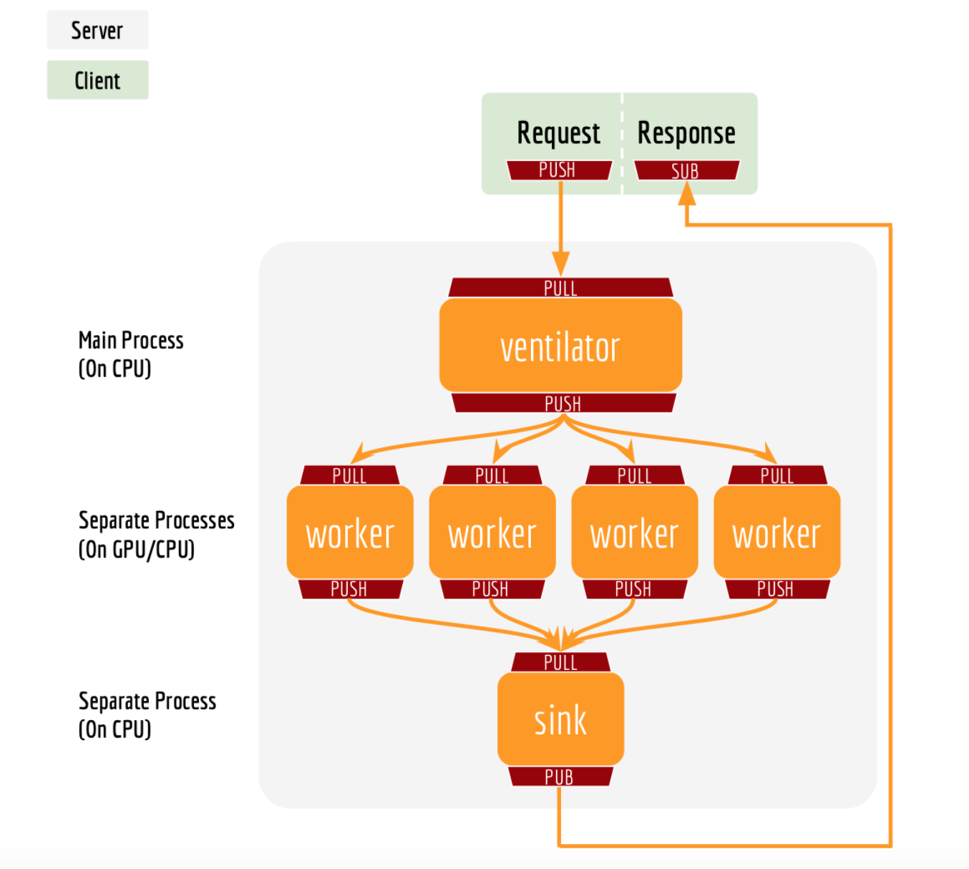
Serve Features
“BERT as a service” https://github.com/hanxiao/bert-as-service/

Slide 65
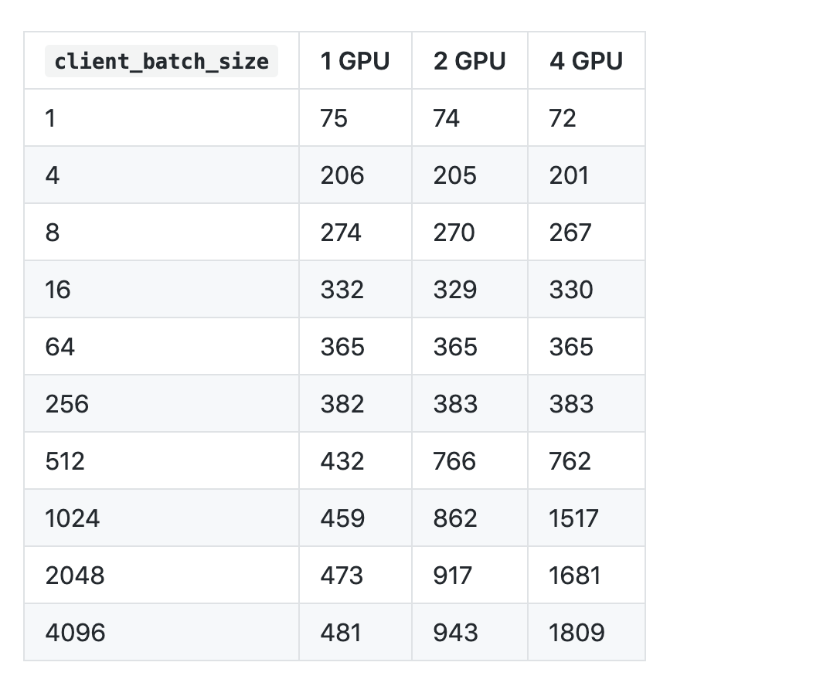
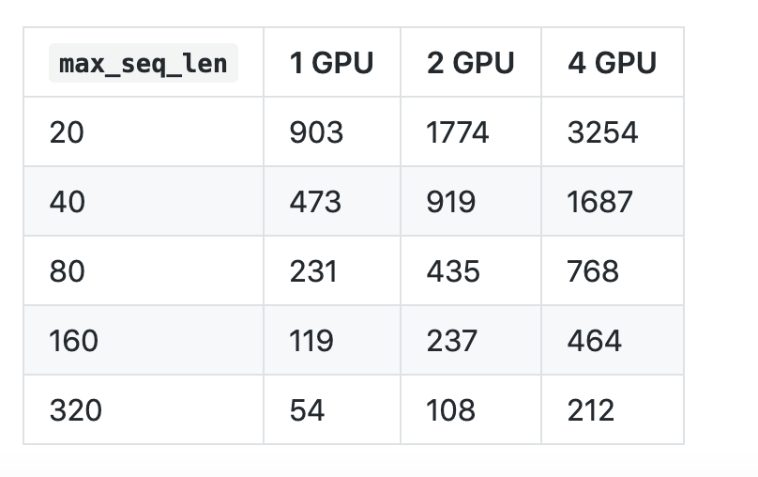
Benchmark
Throughput: req/second
“BERT as a service” https://github.com/hanxiao/bert-as-service/

Slide 66
Open Questions and Challenges
A lot of work is needed into understanding the role of each layer in the BERT architecture
How far can we go into model compression?
Are all the parameters in BERT necessary?
“The vast majority of heads, especially the encoder self-attention heads, can be removed without seriously affecting performance.” https://arxiv.org/abs/1905.09418
Architecture search for model compression?
Let’s start with the first set of slides

Slide 67
4. Correlation vs Causation

Slide 68
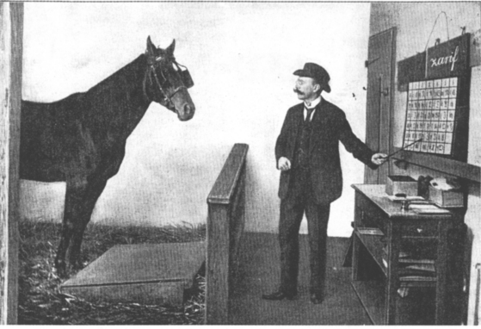
Clever Hans

Slide 69
Clever BERT?

Slide 70
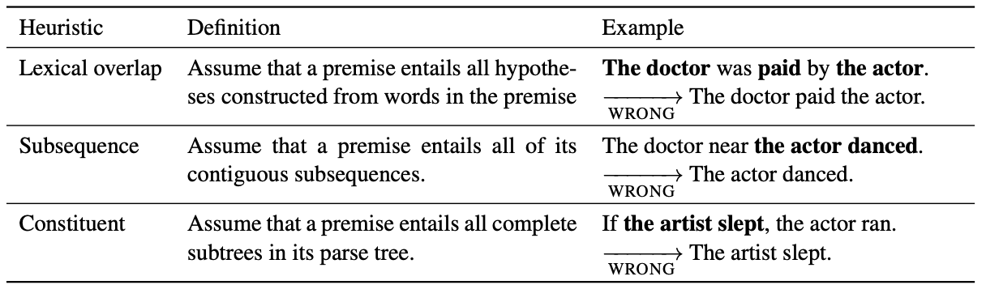
Clever BERT?
Example of superficial syntactic property for entailment:
Researchers built a dataset around those and discovered current models were using those shortcuts
“Right for the Wrong Reasons: Diagnosing Syntactic Heuristics in Natural Language Inference” https://www.aclweb.org/anthology/P19-1334.pdf

Slide 71
Clever BERT?
The paper shows that Bert “closely tracks statistical regularities in the training set”
→ Which is prone to adopting superficial heuristics
Good test data is the most valuable there is!
→ It’s ok to have a test and train dataset from different distribution if the test data is better matching what you’re aiming for.
A lot of work need to be done to understand what models are exactly learning
“Right for the Wrong Reasons: Diagnosing Syntactic Heuristics in Natural Language Inference” https://www.aclweb.org/anthology/P19-1334.pdf

Slide 72
Thank You for Your “Self” Attention

